Slide 2
What Do You Know about Bullying?
Do you know anybody who has been bullied?
Have you ever been bullied?
Bullying is hurting someone on purpose, over and over again.
It can happen face to face with actions or with words or it can happen online through a phone, tablet or computer.

Slide 3
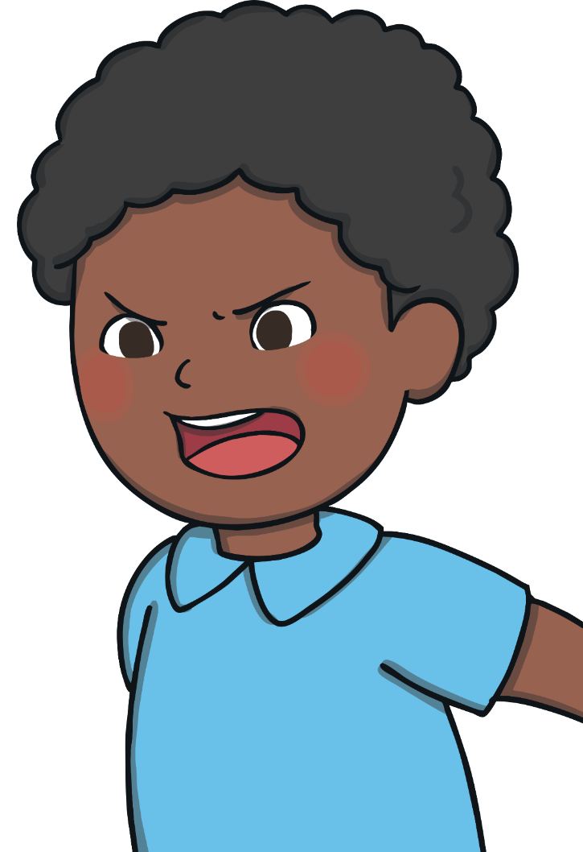
What Is Bullying?
Remember, bullying is hurting someone on purpose over and over again. It is not when an unkind thing happens only once.
Bullying can be shouting at or teasing another person.
Bullying can be saying unkind things to somebody or
whispering unkind things about somebody over and over
again.
Bullying can be saying unkind things about someone’s body.
Bullying can be saying unkind things about how somebody looks, what they are wearing or what they are doing.
Bullying can be saying somebody can’t join in or trying to
make someone feel left out on purpose.

Slide 4
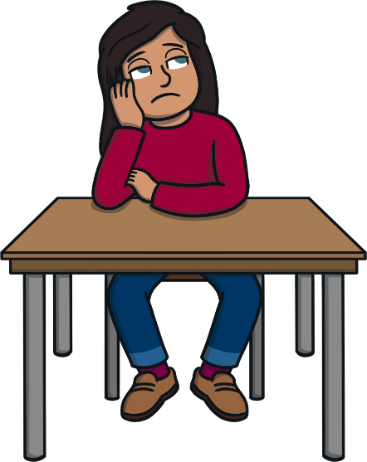
Why Does Bullying Happen?
Bullying sometimes happens because we are all different.
When someone is jealous of someone else’s talents they sometimes say or do unkind things because they think it will make them feel better than the person they are jealous of. In the end it just makes both people feel bad.
People are sometimes unkind when they are jealous of other friendships and they lash out because they feel left out.
People who bully often feel angry or bad about themselves. When someone feels hurt they hurt other people because they think it will make them feel better, but it never does in the long run.
Sometimes people bully because they have been bullied before themselves or they might not understand how their actions hurt others and make them feel bad about themselves

Slide 5
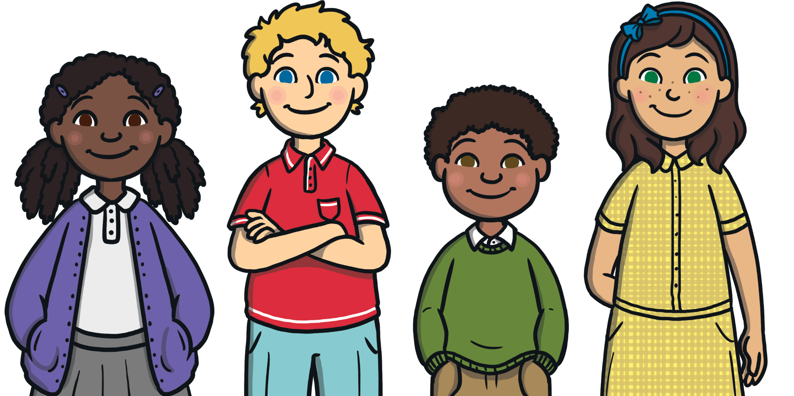
What Is Anti-Bullying Week?
It is an annual event that is held every November.
It aims to raise awareness of bullying, what it looks like and how we can help to stop it happening.

Slide 6
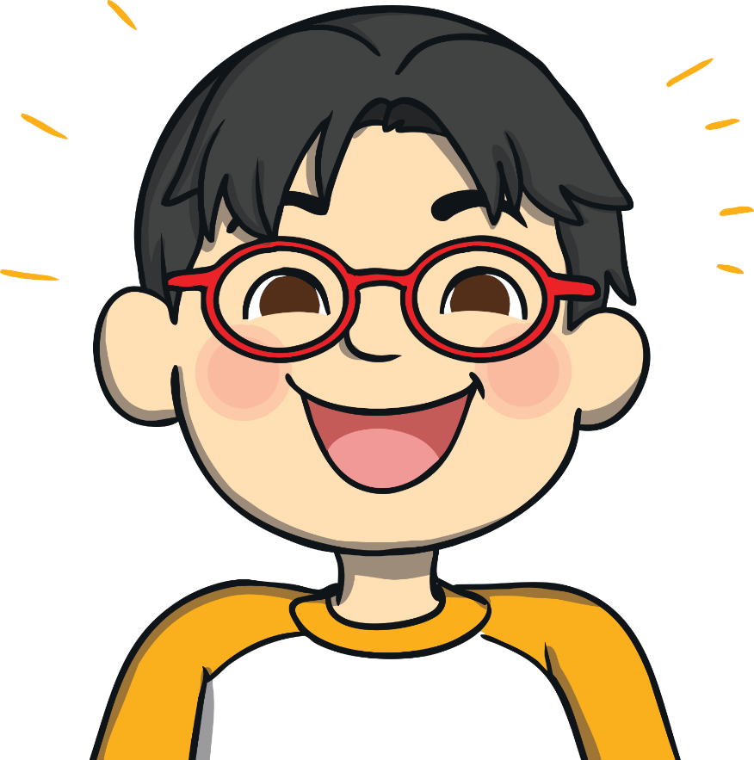
Anti-Bullying Week 2021
In 2021, Anti-Bullying Week begins on Monday 15th until Friday 19th November.
The theme this year is One Kind Word
Kindness is more important today than it has ever been before. Loneliness during Lockdown
has made us more aware of how little acts of kindness can brighten the lives of the people around us and make us
feel good about ourselves too.
Remember: Small actions make a huge impact. Ask someone if they’re OK. Say you’re sorry. Say hello!

Slide 7
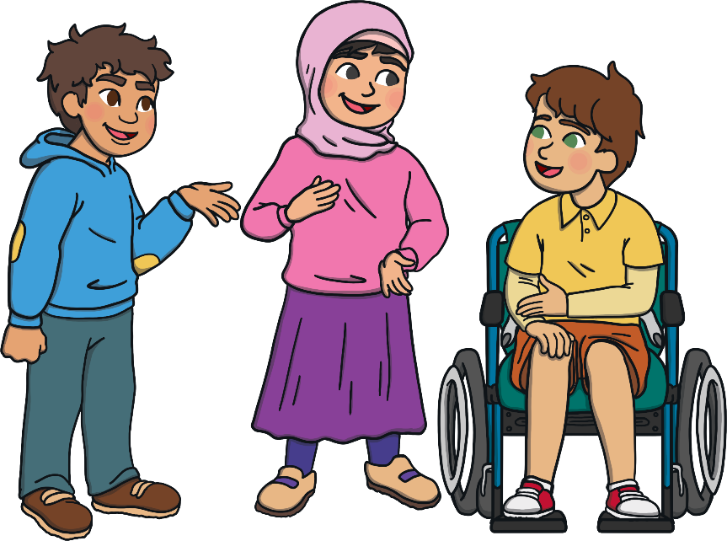
One Kind Word
One kind word can give a moment of hope. Something so small can change someone’s thoughts from bad to good. It can change their day and help to end bullying. One kind word can feel like the sun breaking through the clouds on a rainy day.
One kind word leads to another kind word. Kindness spreads and we can create a chain of kindness.
What words of kindness
could you pass on today?

Slide 8
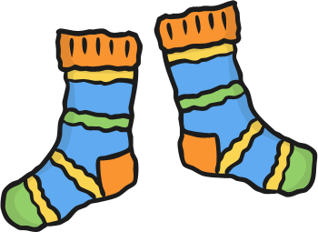
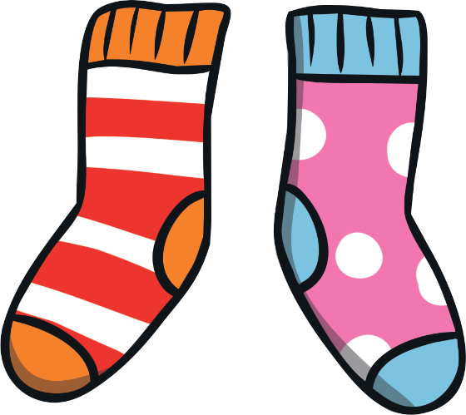
Odd Socks Day
Mental Health Awareness started in Golden NS with an Odd Socks Day.
This is to celebrate how we are all different.
Let’s be kind to each other and love how we are all different. Difference is what makes life interesting and fun!

Slide 9
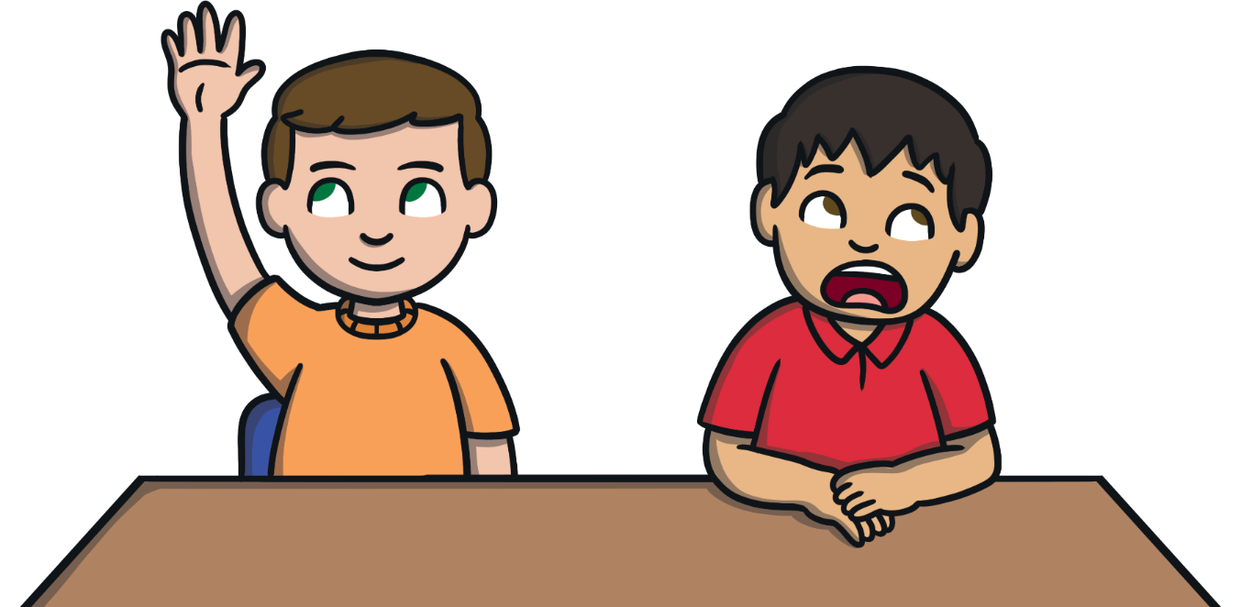
We Are All Different
We are different for lots of different reasons.
eye colour
skin colour
hair colour
family
what we find tricky to do
how we look
likes and dislikes
Can you think of any more?

Slide 10
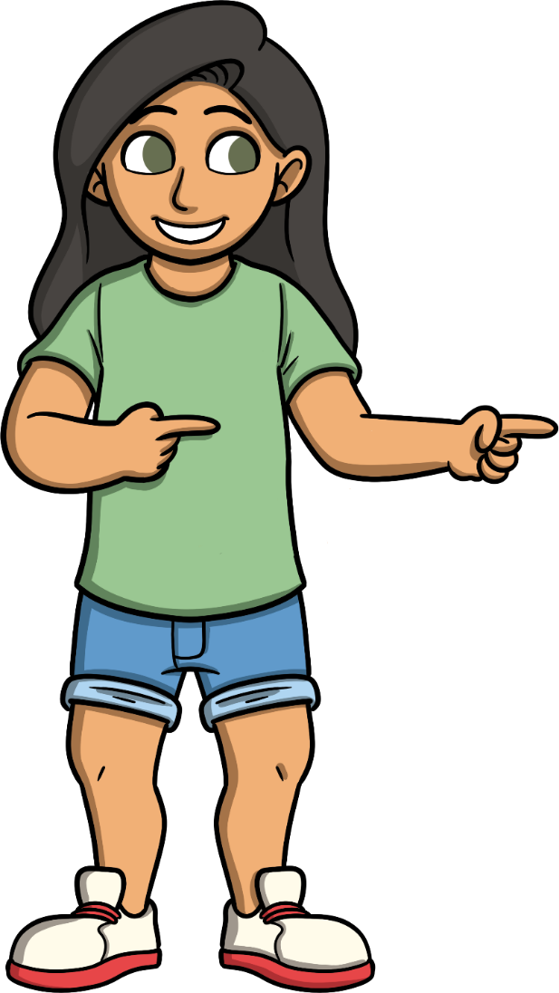
What Should You Do If You Feel You Are Being Bullied?
Tell someone!
Someone can always help. Find a trusted adult and ask them to help you.
Even if it’s not you being bullied, help other people around you. Ask if they are OK or if they need something.
If someone is doing something to you that makes you feel sad or uncomfortable, tell them to stop and if they don’t leave and tell an adult. Sometimes people do not realise the impact of their words or actions until you tell them.

Slide 11
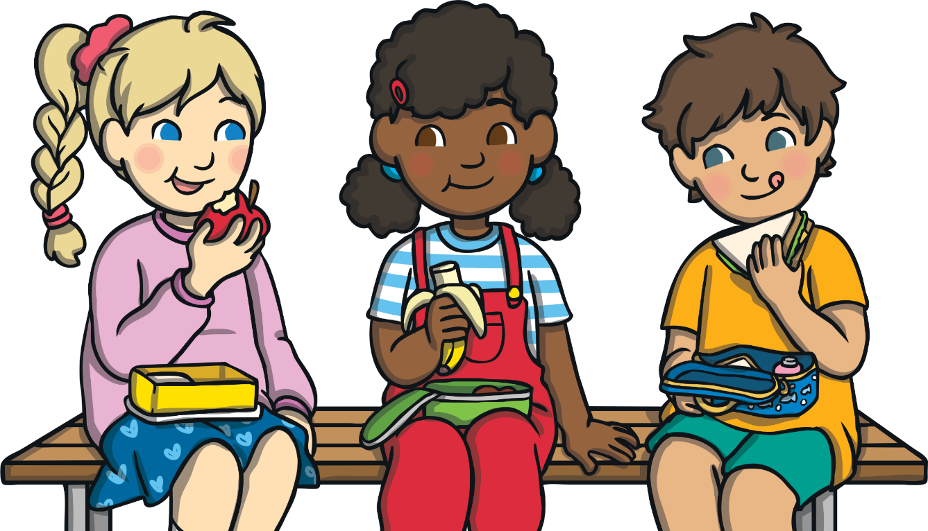
True or False?
You can tell somebody is a bully just by looking at them.
If you are a bully, you will always be a bully.
Bullies make people feel upset.
Nobody should be bullied because they are different.
false
false
true
true

